Slide 1
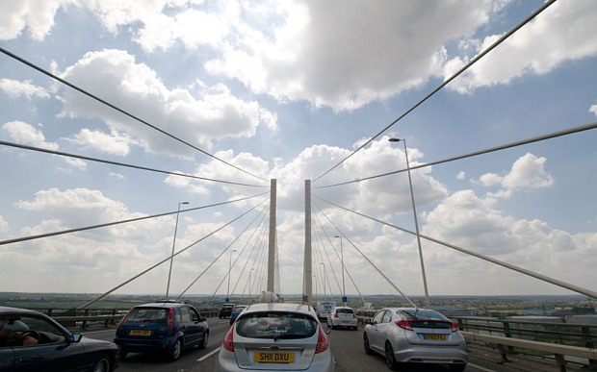
Colossians 2v18-19 – fear of missing out
Changing lanes

Slide 2
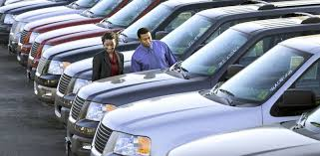
Colossians 2v18-19 – fear of missing out
Changing cars

Slide 3
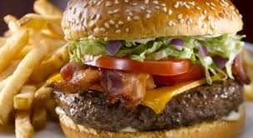
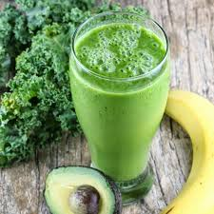
Colossians 2v18-19 – fear of missing out
Changing diets

Slide 4
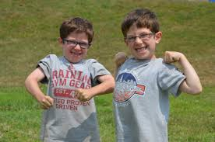
Colossians 2v18-19 – the in crowd
Desperation not to be picked last

Slide 5
Colossians 2v18-19 – the in crowd
The desire to be in the inner circle is one of the “great permanent mainsprings of human action.” C.S Lewis

Slide 6
Colossians 2:18-19 In with the in crowd
¹⁸ Do not let anyone who delights in false humility and the worship of angels disqualify you for the prize. Such a person also goes into great detail about what he has seen; and his unspiritual mind puffs him up with idle notions.
¹⁹ He has lost connection with the Head, from whom the whole body, supported and held together by its ligaments and sinews, grows as God causes it to grow.

Slide 7
Colossians 2:18-19 In with the in crowd
Paul’s 3rd warning in this block:-
v8 – see to it that no one takes you captive
v16 – do not let anyone judge you
v18 – do not let anyone disqualify you

Slide 8
Colossians 2:18-19 In with the in crowd
Paul’s 3rd warning in this block:-
v8 – see to it that no one takes you captive
Jesus has disarmed those powers/triumphed at the cross
v16 – do not let anyone judge you
Jesus is the reality that fulfilled the shadows
v18 – do not let anyone disqualify you
What is the answer likely to be?

Slide 9
Col 2:18-19 problems in the passage
¹⁸ Do not let anyone who delights in false humility and the worship of angels disqualify you for the prize.
What is the prize?
Salvation? No
Let’s look at the context Col 2v6-7
“So then, just as you received Christ Jesus as Lord, continue to live your lives in Him, rooted and built up in Him, strengthened in the faith as you were taught, and overflowing with thankfulness”

Slide 10
Col 2:18-19 problems in the passage
¹⁸ Do not let anyone who delights in false humility and the worship of angels disqualify you for the prize.
What is the prize?
Mature, strong, joyous faith
How do we get the prize?
Just as you received Christ Jesus...continue to live in Him – v6

Slide 11
Col 2:18-19 problems in the passage
¹⁸ Do not let anyone who delights in false humility and the worship of angels disqualify you for the prize.
What is the worship of angels?
Praying to other mediators who intercede?
Fits with humility
Supported by error in the region – Synod at Laodicea AD363 “It is not right for Christians to abandon the church of God and go away to invoke angels”

Slide 12
Col 2:18-19 problems In the passage
¹⁸ Do not let anyone who delights in false humility and the worship of angels disqualify you for the prize.
What is the worship of angels?
Other mediators who intercede
Fits with humility
Worshipping the angels in place of God?
Clear error - Matthew 4v10 - Jesus said to him, “Away from me, Satan! For it is written: ‘Worship the Lord your God, and serve Him only.’”

Slide 13
Col 2:18-19 problems In the passage
What is the worship of angels?
Other mediators who intercede
Worshipping angels in place of God
Or worship in the style of angels
Fits with elitism/inner circle
Fits with 1 Cor – tongues of angels
Applicable today
Style of worship is divisive –
Heart – not looking down on others

Slide 14
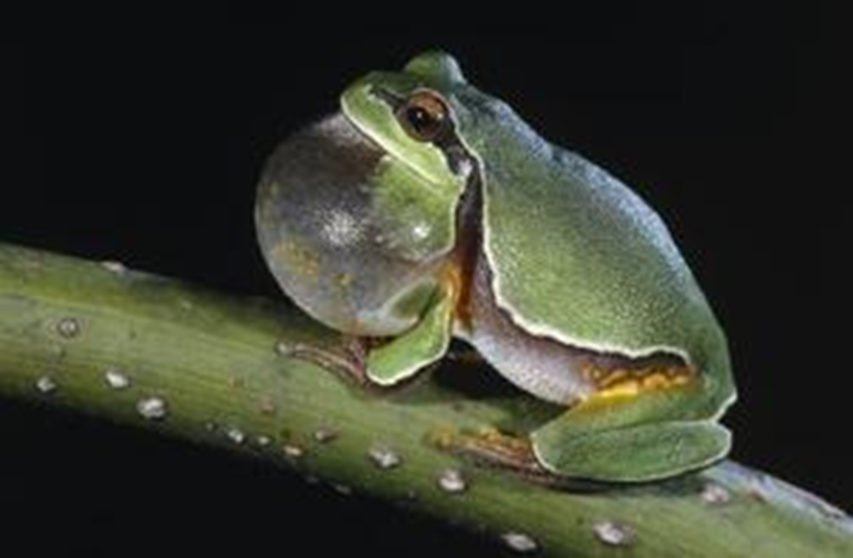
Colossians 2:18-19 false humility
¹⁸ Do not let anyone who delights in false humility and the worship of angels disqualify you for the prize. Such a person also goes into great detail about what he has seen; and his unspiritual mind puffs him up with idle notions.

Slide 15
Colossians 2:18-19 In with the in crowd
¹⁸ Do not let anyone who delights in false humility and the worship of angels disqualify you for the prize. Such a person also goes into great detail about what he has seen; and his unspiritual mind puffs him up with idle notions. NIV
“intruding into those things which he has not seen” NKJV
What is the issue here?
Things not revealed – his experience over scripture
Majoring on minors
Making less of Christ and less of grace

Slide 16
Colossians 2:18-19 In with the in crowd
The false teacher’s problem
¹⁹ He has lost connection with the Head, from whom the whole body, supported and held together by its ligaments and sinews, grows as God causes it to grow.
He has lost his head!
Lost support and God given growth

Slide 17
Colossians 2:18-19 In with the in crowd
Do not let anyone cheat you of your reward
Avoid the catastrophic lure of Jesus plus teaching
Stay connected to the Head
Not visions but the Word of God
Jesus first and last
Stay linked to the body
Unity of His body – not puffed up

